Slide 1
Dating VIOLENCE (Abuse)
Phd.C. Bilcan Bladanlı
AHSS204 – November 2019
Bilcan.bladanli@cc.emu.edu.tr

Slide 2
WHAT IS VIOLENCE?
As stated by World Health Organization (WHO) in the World report on violence and health (WRVH) (2002), violence is;
The intentional use of physical force or power,
threatened or actual,
against oneself, another person,
or against a group or community,
which either results in or has a high likelihood of resulting in injury, death, psychological harm, maldevelopment, or deprivation.

Slide 3
As the World Health Organization (WHO) indicates, violence has a content that emphasizes both physical and non-physical negative behavior.
WHO divides the general definition of violence into three sub-types.
Self-directed violence,
Interpersonal violence,
and collective violence.

Slide 4
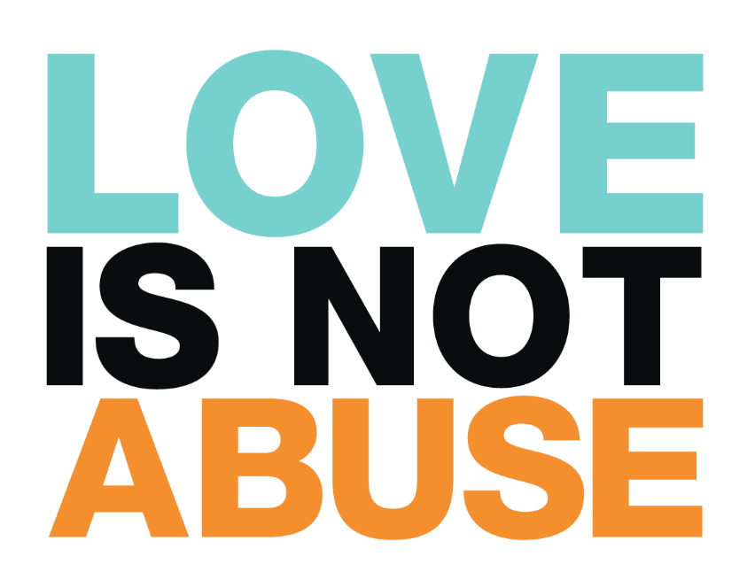
GENDER & VIOLENCE

Slide 5
GENDER BASED VIOLENCE - GBV
https://www.youtube.com/watch?v=3AF9Rjki0DE

Slide 6
GENDER BASED VIOLENCE - GBV
Despite the fact that there are only biological differences between men and women, this has changed over the centuries and has turned into an unreal social difference.
Therefore, biological sex is genetic, but gender is a concept not of biological differences only but of how a society as a man and a woman sees, perceives, thinks and behaves as individuals (Yumuşak, 2013).
Concept of gender; together with defining roles, duties, rights, responsibilities and behaviors that have been attributed to women and men determined by both society and culture.
These roles, duties, rights, responsibilities and behaviors for women and men can vary from culture to culture (Sabuncuoğlu, 2006).

Slide 7
The gender roles in the light of all these is the sex-related anticipations that are defined by the society and which the things expected from individuals to fulfill.
In other words, being a woman and being a man is to be expressed in the social environment (Güçlü-Ergin, 2008; Dökmen, 2012). Over time this situation continues as a pattern of behaviors that should and should not be done as men and women (Kaçar, 2007).
This situation actually causes the individuals to determine the sexist stereotype. Stereotypes include a set of specific personal attributes and categories (Baumeister & Bushman, 2008).
Gender stereotypes are characteristics that society expects to exist in women and men (Dökmen, 2012).

Slide 8
There are stereotypes not only for women but also for men in society. Society builds these identities by placing certain responsibilities and roles within the hierarchy of men and women (Agacinski, 1998).
However, it can not be said that these roles are completely related to innate features, but rather to cultural learning and transmission.
According to these roles men are aggressive, independent and active while women are defined as more naive, passive and individuals with high social cohesion.
These patterns exist in the form of judgments like “If the woman deserves it, it is normal for the man to commit violence” and “If a woman is beaten by her husband, she should hide it” (Vefikuluçay, Zeyneloğlu, Eroğlu, & Taşkın, 2007).
Studies show that it is very difficult to change stereotypes about traditional gender roles.

Slide 9
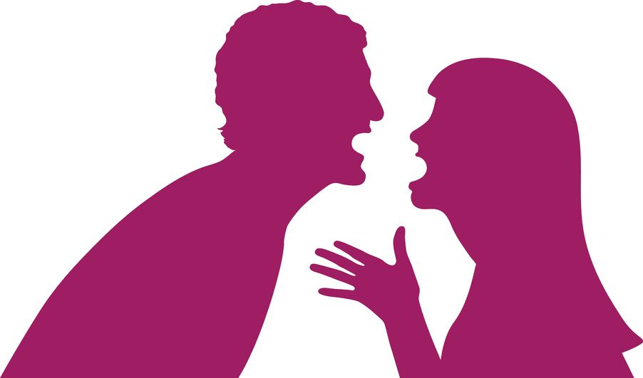
In terms of dating relationships, having such judgments can also cause problems in relationships and couples can physically and psychologically violate one another.
Power balances, inequalities are leading to oppression and violence, and also some cultural patterns are causing these power imbalances and inequalities.
It is of utmost importance for men to think that men are always privileged and that they have the power to control women in male and female roles.
And Women that they generally hold themselves responsible for situations that go against human relationships and that they consider men to be sane in their own goodness (Aslan et. al, 2008).

Slide 10
DATING VIOLENCE
According to the WHO People between the ages of 18-25 are categorized as adolescence period. Adolescence is the period when violence comes forward.
The adolescence period is also the period when substance use, nutritional disorders, mental problems and risky behaviors and especially reproductive health problems frequently seen.
In addition, in the university years when the transition to adulthood becomes with cognitive, social and emotional changes, romantic relationships and having a partner become an important role in the development of the individual.
Dating relationships also contribute to the socialization of young people by forming their identity and independence from their parents.
In addition, from their relationships young people learn about cooperation with their partners, mutual understanding, responsibility and social duties.

Slide 11
Individuals who are involved in dating can sometimes resort to violent behaviors towards their date in order to solve the problems they experience (Atakay, 2014).
According to Office of Women’s Health in the U.S. Department of Health and Human Services (2017);
“Dating violence is physical, sexual, emotional, or verbal abuse from a romantic or sexual partner.”
It is a type of interpersonal violence.
According to the researches this type of violence is often starts with verbal and/or emotional abuse.

Slide 12
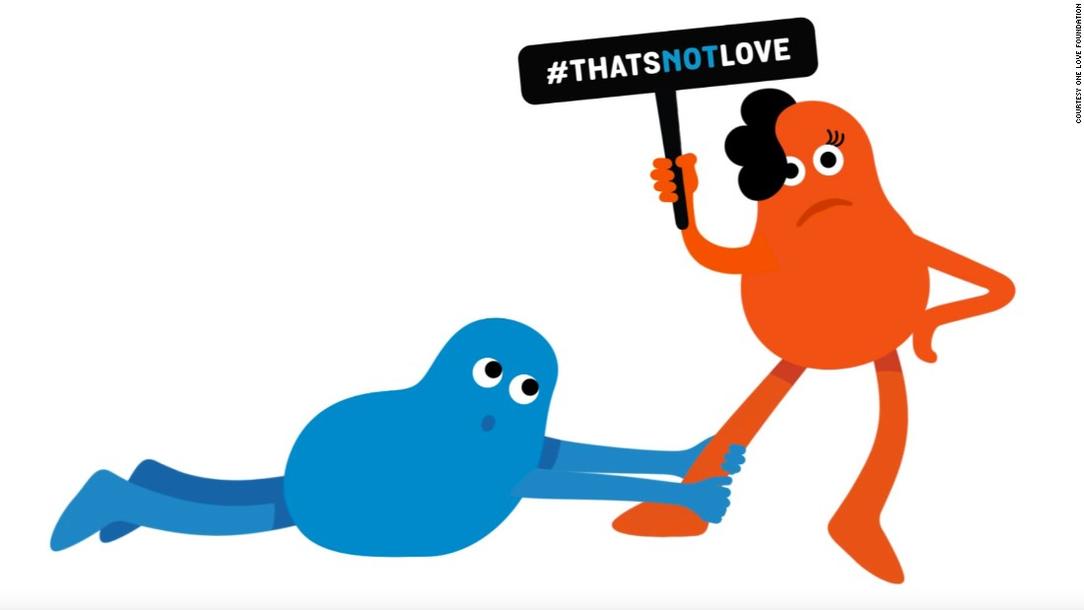
According to The National Domestic Violence Hotline (2018), relationships may not be visibly abusive from the beginning.
Possessive and controlling behaviors don’t appear suddenly, yet emerge and increase as the relationship grows (The National Domestic Violence Hotline, 2018).
There is no specific time to occur for the dating abuse, it can be arise even on the first date of couples.
Dating abuse/violence is defined by the repetition of certain behavior patterns; but that does not mean that the first act was not violence.
It is also within the scope of dating violence to decide what to wear, where to go, or whom to meet with.

Slide 13
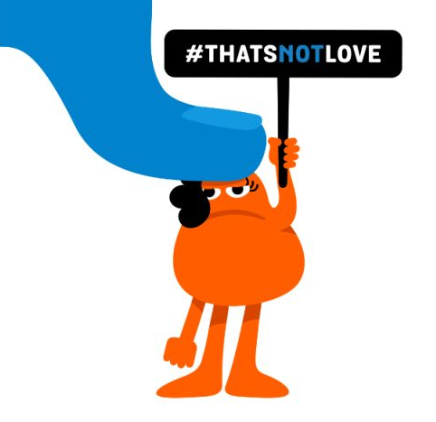
The subject of violence generally accepts this as a sign of love. "He/she loves me, jealous of me, takes care of me". But these kinds of jealous behaviors are the clearest examples of dating violence.
Jealousy is a strong warning for negative behavior, such as controlling the person opposite and being in repressive positions.
In 2017 an association called Cinsel Şiddetle Mücadele Derneği in Turkey did a project called “Ne Var Ne Yok Projesi”. According to the results of the survey which is conducted with 3153 young people studying in seven different high schools in Istanbul, if a behavior is not sufficiently physical, the participants are less likely to describe it as "violence".

Slide 14
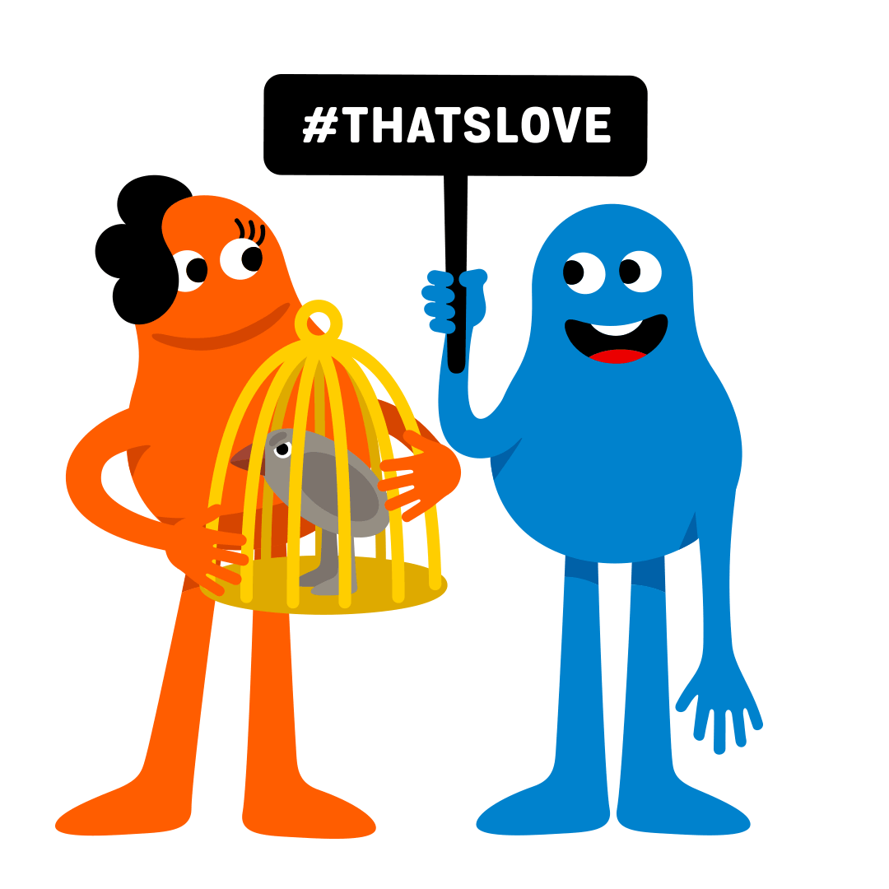
This results clearly shows us that adolescents do not really know much about the concept of violence and that they are not good at defining and describing violence.
Furthermore, according to the research conducted in Turkey by Özcebe et al. (2002), 31.6% of the 148 university students who participated in the survey stated that, they were a friend of one who exposed to violence during the dating relationship and 87.8% of them were female.
And also, according to a survey conducted in 2008 on students studying at two different nursing colleges in Ankara-Turkey, 1 out of every 5 students is subjected to dating violence (Aslan, Vefikuluçay, Zeyneloğlu, Erdost, & Temel, 2008).

Slide 15
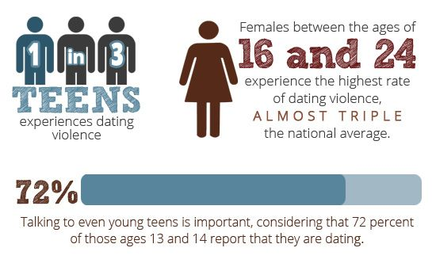
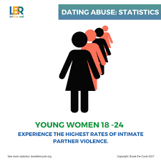
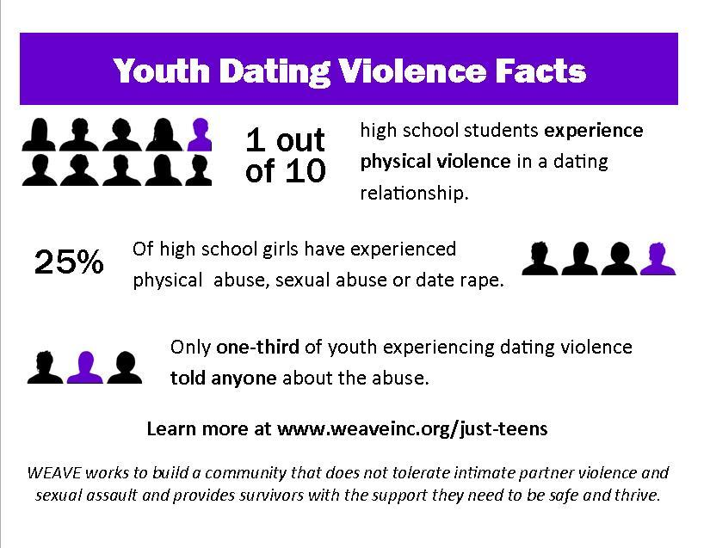
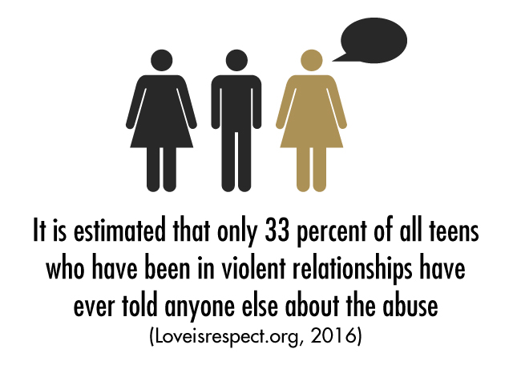
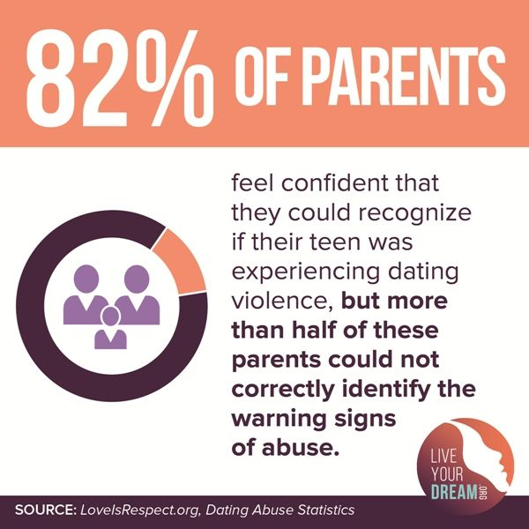

Slide 17
TYPES OF DATING VIOLENCE

Slide 18
No is NO!
https://www.youtube.com/watch?v=fGoWLWS4-kU&list=PLvxPySPZndKWRrGyU6MbLo6YbeNQ__fjG
What is CONSENT! ???

Slide 20
HOW THIS KIND OF RELATIONSIP CONTINUES?
Warning Signs:
https://www.youtube.com/watch?v=NMDJkWl7E2A

Slide 23
Why we insist on...
People who have never been abused often wonder why a person wouldn’t just leave an abusive relationship. They don’t understand that breaking up can be more complicated than it seems(Loveisrespect.org).
There are many reasons why people stay in abusive relationships. There are some of the Myths...
A relationship is better than having nothing...
Not knowing what is really violence.
May not having another relationship to compare with.
This is how the love is... Effect of media, excessive jealousy, ownership and violence is presented as an indicator of love.
I'm in love with him/her. I want to end violence, but continue the relationship.

Slide 24
Conflicting Emotions
Fear: Your friend may be afraid of what will happen if they decide to leave the relationship. If your friend has been threatened by their partner, family or friends, they may not feel safe leaving.
Believing Abuse is Normal: If your friend doesn’t know what a healthy relationship looks like, perhaps from growing up in an environment where abuse was common, they may not recognize that their relationship is unhealthy.
Fear of Being Outed: If your friend is LGBTQ+ and has not yet come out to everyone, their partner may threaten to reveal this secret. Being outed may feel especially scary for young people who are just beginning to explore their sexuality.
Embarrassment: It’s probably hard for your friend to admit that they’ve been abused. They may feel they’ve done something wrong by becoming involved with an abusive partner. They may also worry that their friends and family will judge them.
Low Self-esteem: If your friend’s partner constantly puts them down and blames them for the abuse, it can be easy for your friend to believe those statements and think that the abuse is their fault.
Love: Your friend may stay in an abusive relationship hoping that their abuser will change. Think about it — if a person you love tells you they’ll change, you want to believe them. Your friend may only want the violence to stop, not for the relationship to end entirely.

Slide 25
Pressure
Social/Peer Pressure: If the abuser is popular, it can be hard for a person to tell their friends for fear that no one will believe them or that everyone will take the abuser’s side.
Cultural/Religious Reasons: Traditional gender roles can make it difficult for young women to admit to being sexually active and for young men to admit to being abused. Also, your friend’s culture or religion may influence them to stay rather than end the relationship for fear of bringing shame upon their family.
Pregnancy/Parenting: Your friend may feel pressure to raise their children with both parents together, even if that means staying in an abusive relationship. Also, the abusive partner may threaten to take or harm the children if your friend leaves.

Slide 26
Distrust of Adults or Authority
“It’s Just Puppy Love” Adults often don’t believe that teens really experience love. So, if something goes wrong in the relationship, your friend may feel like they have no adults to turn to or that no one will take them seriously.
Distrust of Police: Many teens and young adults do not feel that the police can or will help them, so they don’t report the abuse.
Language Barriers/Immigration Status: If your friend is undocumented, they may fear that reporting the abuse will affect their immigration status.
Also, if their first language isn’t the local one, it can be difficult to express the depth of their situation to others.

Slide 27
Reliance on the Abusive Partner
Lack of Money: Your friend may have become financially dependent on their abusive partner. Without money, it can seem impossible for them to leave the relationship.
Nowhere to Go: Even if they could leave, your friend may think that they have nowhere to go or no one to turn to once they’ve ended the relationship. This feeling of helplessness can be especially strong if the person lives with their abusive partner.
Disability: If your friend is physically dependent on their abusive partner, they can feel that their well-being is connected to the relationship. This dependency could heavily influence his or her decision to stay in an abusive relationship.

Slide 28
According to the related literature, factors that increase the risk of exposure to dating violence for women are;
to start dating in early ages,
to engage in sexual activity in the early years,
to experience violence in the past,
to adopt gender roles and violence against women.
The factors that cause males to be perpetrators of dating violence are;
alcohol and substance abuse,
inadequate communication skills,
witnessing or exposure to interpersonal violence,
and the belief that men are superior to women in relation to the cause of gender roles,
and that violence is a normal form of behavior (Aslan et. al, 2008)

Slide 29
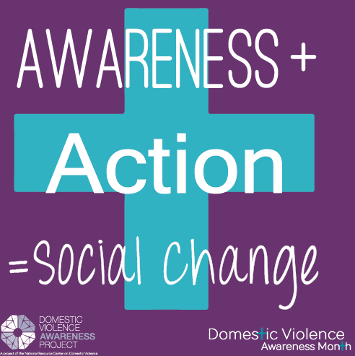
What Can We Do?
If you have friends or family members who are in unhealthy or abusive relationships, the most important thing you can do is be supportive and listen to them.
Please don’t judge!
Understand that leaving an unhealthy or abusive relationship is never easy.
Try to let your friend know that they have options.
Invite them to check out resources like www.loveisrespect.org, even if they stay in the abusive relationship.
Tell them about CALL 183

Slide 30
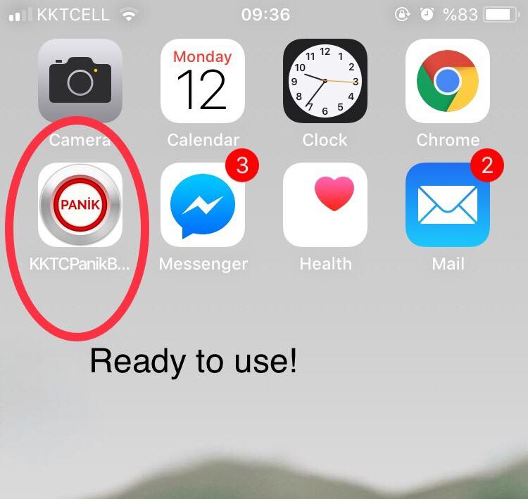
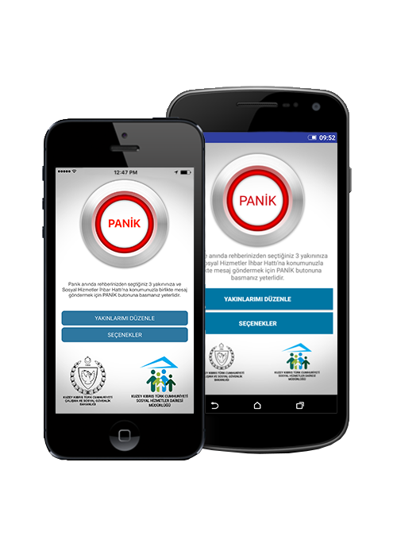
EMU-CWS
CALL HOTLINE 183 (TRNC)
Mob. APP- PANIC BUTTON
Dating violence can be considered as a first step of domestic violence which is the big problem for every country.
And it is a hazardous factor for public health, besides individual problem.

Slide 31
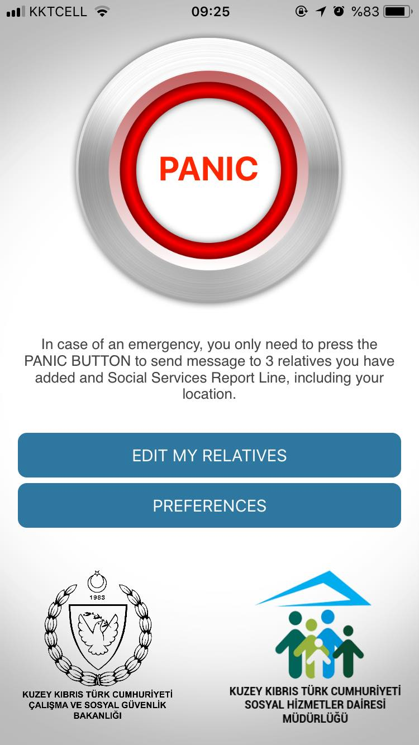
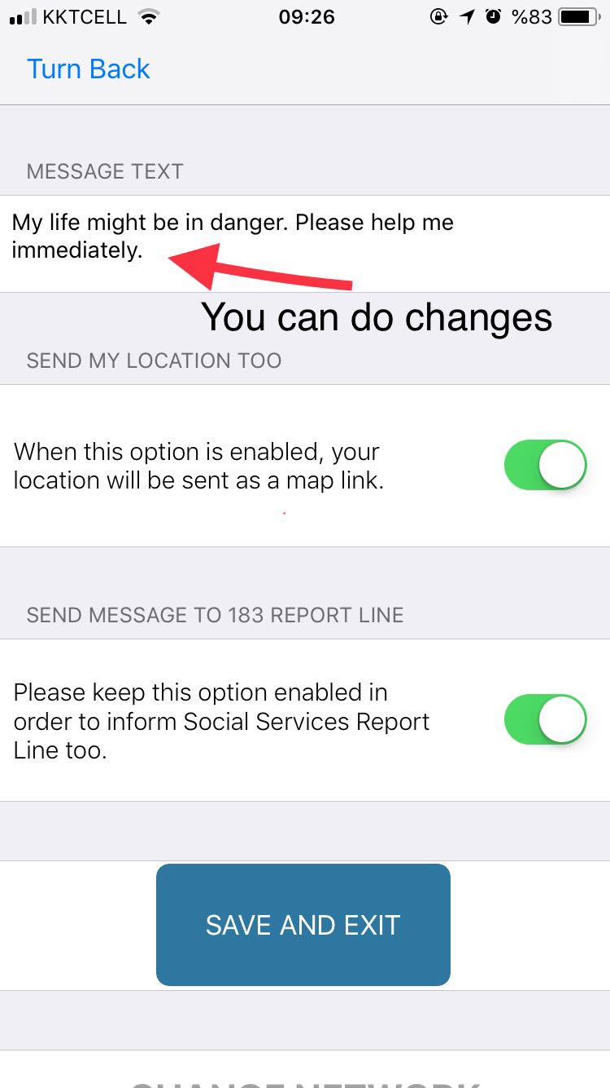

Slide 32
References:
Love is Respect.org
Bladanlı,B.(2018) Dating Violence and Digital Dating Abuse among University Students: Case of EMU. MA Thesis.Eastern Mediterranean University, August 2018
THANK YOU
https://www.youtube.com/watch?v=4JYyHa03x-U

